Slide 1


SOCIAL BUZZ
Analysis

Slide 2


Today's agenda
Project recap
Problem
The Analytics team
Process
Insights
Summary

Slide 3

wsss
Social Buzz is a fast-growing technology unicorn that need to adapt quickly to its global scale.
Accenture has begun a 3-month POC focusing on these tasks:
An audit of Social Buzz’s big data practice
Recommendations for a successful IPO
Analysis to find Social Buzz’s top 5 most popular categories of content
Project Recap

Slide 4

Problem
Over 100000 posts per day
36,500,000 pieces of Content per year!
But how to capitalize on it when there is so much?
Analysis to find social Buzz’s top 5 categories of content

Slide 5




Emma Fleming
Chief Technical Architect
The Analytics team
Marcus Rompton
Senior Principle
Sarthak Saharan
Data Analyst

Slide 6
Process
1
Data Understanding
2
Data Cleaning
3
Data Modelling
4
Data Analysis
5
Uncover Insights

Slide 7
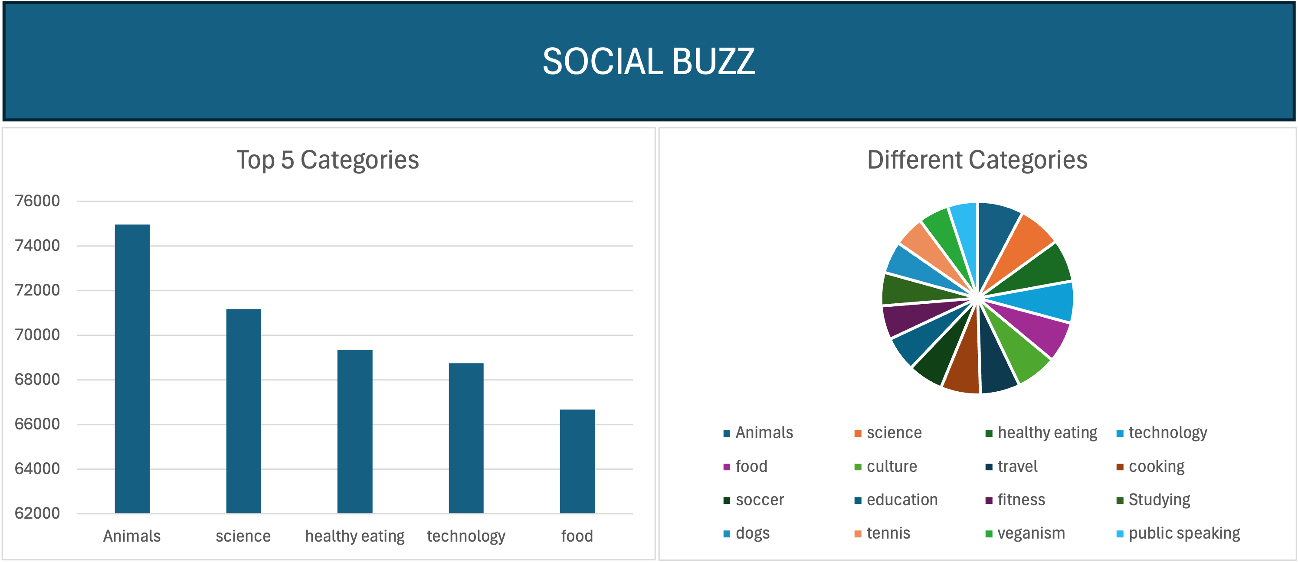

Insights

Slide 8

TOP 5 CATEGORIES OF CONTENT:
Animals
science
healthy eating
technology
food
Summary

Slide 9

Thank you!
ANY QUESTIONS?

